Slide 1
Copyright Notice
These slides are distributed under the Creative Commons License.
DeepLearning.AI makes these slides available for educational purposes. You may not use or distribute these slides for commercial purposes. You may make copies of these slides and use or distribute them for educational purposes as long as you cite DeepLearning.AI as the source of the slides.
For the rest of the details of the license, see https://creativecommons.org/licenses/by-sa/2.0/legalcode

Slide 2
Model Management and Delivery
Welcome

Slide 3
ML Experiments Management and Workﬂow Automation
Experiment Tracking

Slide 4

Why experiment tracking?
ML projects have far more branching and experimentation
Debugging in ML is difﬁcult and time consuming
Small changes can lead to drastic changes in a model’s performance and resource requirements
Running experiments can be time consuming and expensive

Slide 5
What does it mean to track experiments?
Enable you to duplicate a result
Enable you to meaningfully compare experiments
Manage code/data versions, hyperparameters, environment, metrics
Organize them in a meaningful way
Make them available to access and collaborate on within your organization

Slide 6

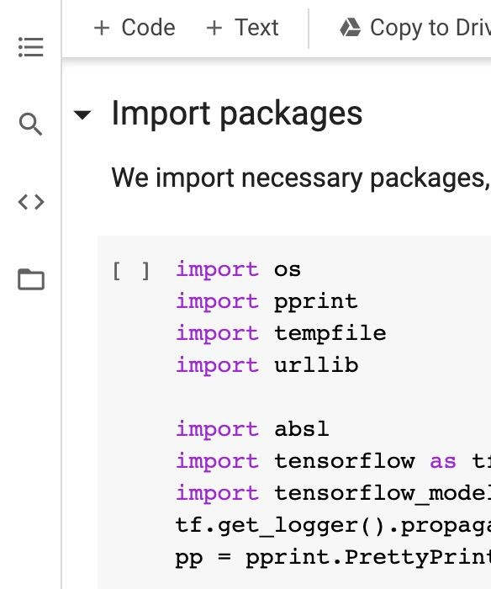
Simple Experiments with Notebooks
Notebooks are great tools
Notebook code is usually not promoted to production
Tools for managing notebook code
nbconvert (.ipynb -> .py conversion)
nbdime (difﬁng)
jupytext (conversion+versioning)
neptune-notebooks (versioning+difﬁng+sharing)

Slide 7

Smoke testing for Notebooks
jupyter nbconvert --to script train_model.ipynb python train_model.py;
python train_model.py

Slide 8


Not Just One Big File
Modular code, not monolithic
Collections of interdependent and versioned ﬁles
Directory hierarchies or monorepos
Code repositories and commits

Slide 9
Tracking Runtime Parameters
Config files
Command line
data:
train_path: '/path/to/my/train.csv' valid_path: '/path/to/my/valid.csv'
model:
objective: 'binary' metric: 'auc' learning_rate: 0.1
num_boost_round: 200
num_leaves: 60
feature_fraction: 0.2
python train_evaluate.py \
--train_path '/path/to/my/train.csv' \
--valid_path '/path/to/my/valid.csv' \
-- objective 'binary' \
-- metric 'auc' \
-- learning_rate 0.1 \
-- num_boost_round 200 \
-- num_leaves 60 \
-- feature_fraction 0.2

Slide 10
Log Runtime Parameters
parser = argparse.ArgumentParser() parser.add_argument('--number_trees') parser.add_argument('--learning_rate') args = parser.parse_args()
neptune.create_experiment(params=vars(args))
...
# experiment logic
...

Slide 11
ML Experiments Management and Workﬂow Automation
Tools for Experiment Tracking

Slide 12
Data Versioning
Data reﬂects the world, and the world changes
Experimental changes include changes in data
Tracking, understanding, comparing, and duplicating experiments includes data

Slide 13
Tools for Data Versioning
Neptune
Pachyderm
Delta Lake
Git LFS
DoIt
lakeFS
DVC
ML-Metadata

Slide 14
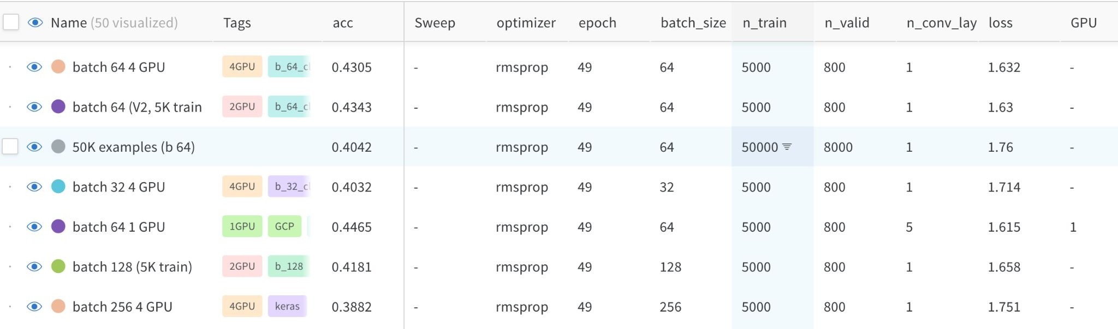
Experiment tracking to compare results

Slide 15

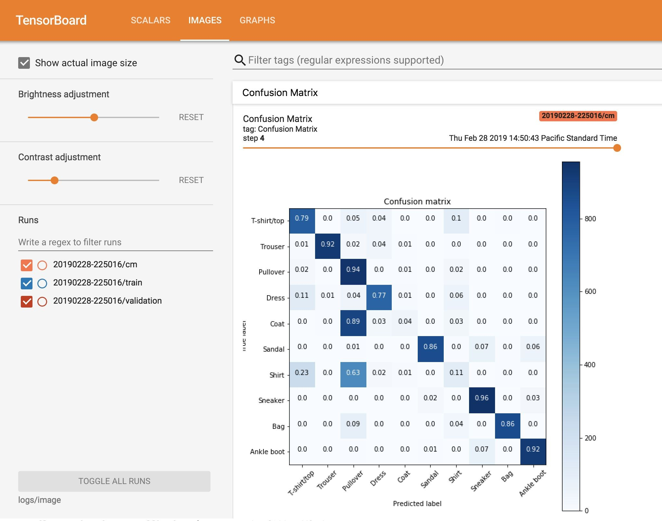
Example: Logging metrics using TensorBoard
logdir = "logs/imag tensorboard_callbac cm_callback = keras model.fit(... callb | e/" + datetime.now().strftime("%Y%m%d-%H%M%S") k = keras.callbacks.TensorBoard(log_dir=logdir, .callbacks.LambdaCallback(on_epoch_end=log_confu acks=[tensorboard_callback, cm_callback]) | histogram_freq=1) sion_matrix)

Slide 16
Organizing model development
Search through & visualize all experiments
Organize into something digestible
Make data shareable and accessible
Tag and add notes that will be meaningful to your team

Slide 17
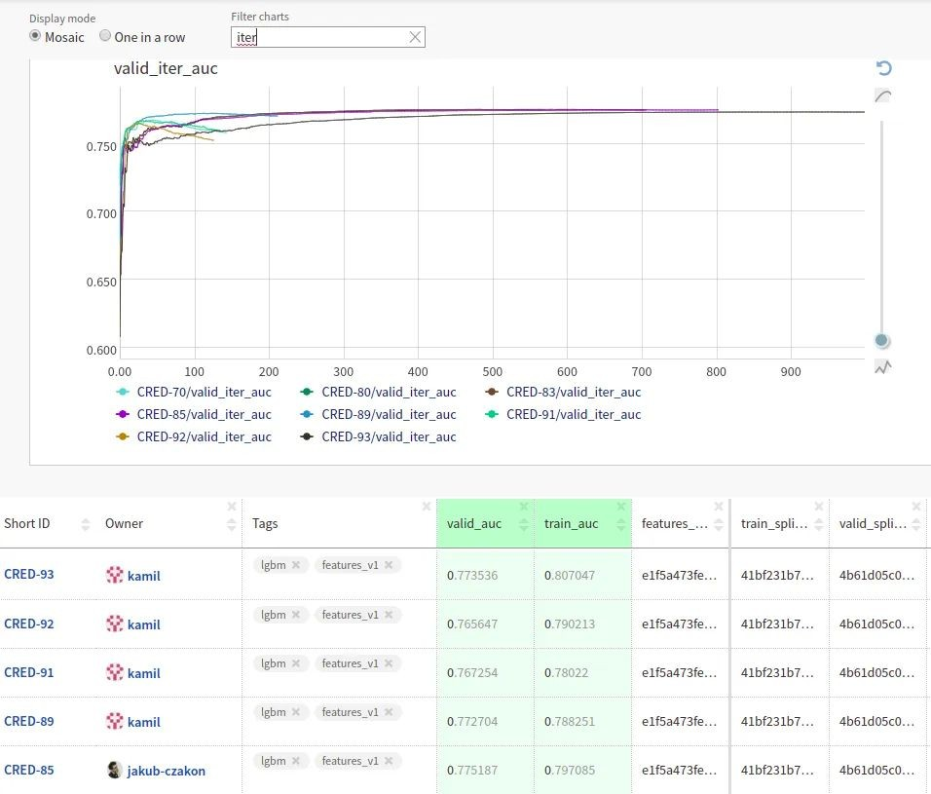
Tooling for Teams

Slide 18

Tooling for Teams
Vertex TensorBoard
Managed service with enterprise-grade security, privacy, and compliance
Persistent, shareable link to your experiment dashboard
Searchable list of all experiments in a project

Slide 19
Experiments are iterative in nature
Creative iterations for ML experimentation
Deﬁne a baseline approach
Develop, implement, and evaluate to get metrics
Assess the results, and decide on next steps
Latency, cost, fairness, etc.

Slide 20
ML Experiments Management and Workﬂow Automation
Introduction to MLOps

Slide 21
Data Scientists vs. Software Engineers
Data Scientists
Often work on ﬁxed datasets
Focused on model metrics
Prototyping on Jupyter notebooks
Expert in modeling techniques and feature engineering
Model size, cost, latency, and fairness are often ignored

Slide 22
Data Scientists vs. Software Engineers
Software Engineers
Build a product
Concerned about cost, performance, stability, schedule
Identify quality through customer satisfaction
Must scale solution, handle large amounts of data
Detect and handle error conditions, preferably automatically
Consider requirements for security, safety, fairness
Maintain, evolve, and extend the product over long periods

Slide 23
Growing Need for ML in Products and Services
Large datasets
Inexpensive on-demand compute resources
Increasingly powerful accelerators for ML
Rapid advances in many ML research ﬁelds (such as computer vision, natural language understanding, and recommendations systems)
Businesses are investing in their data science teams and ML capabilities to develop predictive models that can deliver business value to their customers

Slide 24
Key problems affecting ML efforts today
We’ve been here before
In the 90s, Software Engineering was siloed
Weak version control, CI/CD didn’t exist
Software was slow to ship; now it ships in minutes
Is that ML today?
Today’s perspective
Models blocked before deployment
Slow to market
Manual tracking
No reproducibility or provenance
Inefﬁcient collaboration
Unmonitored models

Slide 25
Bridging ML and IT with MLOps
Continuous Integration (CI): Testing and validating code, components, data, data schemas, and models
Continuous Delivery (CD): Not only about deploying a single software package or a service, but a system which automatically deploys another service (model prediction service)
Continuous Training (CT): A new process, unique to ML systems, that automatically retrains candidate models for testing and serving
Continuous Monitoring (CM): Catching errors in production systems, and monitoring production inference data and model performance metrics tied to business outcomes

Slide 26
ML Solution Lifecycle
Experimentation/ Development
Continuous Training
Continuous Monitoring
Model Deployment
Data Scientist/ML Engineering
ML Engineering/Data Scientist
ML Engineering/DevOps Engineer
ML Engineering/DevOps Engineer

Slide 27
Standardizing ML processes with MLOps
ML Lifecycle Management
Model Versioning & Iteration
Model Monitoring and Management
Model Governance
Model Security
Model Discovery

Slide 28
MLOps Methodology
MLOps level 0

Slide 29
What deﬁnes an MLOps process’ maturity?
The level of automation of ML pipelines determines the maturity of the MLOps process
As maturity increases, the available velocity for the training and deployment of new models also increases
Goal is to automate training and deployment of ML models into the core software system, and provide monitoring

Slide 30
MLOps level 0: Manual process
Manual, script-driven, interactive
Local data
Manual Experiment Steps
Exploratory
Data Analysis
Data Preparation
Model
Training
Model Evaluation
Model Analysis

Slide 31
MLOps level 0: Manual process
Disconnection between ML and operations
Local data
Data Science
IT
Manual Experiment Steps
Trained Model
Model Deployment
Exploratory
Data Analysis
Data Preparation
Model
Training
Model Evaluation
Model Analysis
Storage

Slide 32
MLOps level 0: Manual process
Less frequent releases, so no CI/CD
Local data
Data Science
IT
Manual Experiment Steps
Trained Model
Model Deployment
Exploratory
Data Analysis
Data Preparation
Model
Training
Model Evaluation
Model Analysis
Storage

Slide 33
How do you scale?
Deployment and lack of active performance monitoring
Local data
Data Science
IT
Manual Experiment Steps
Trained Model
Model Deployment
Exploratory
Data Analysis
Data Preparation
Model
Training
Model Evaluation
Model Analysis
Storage

Slide 34
Challenges for MLOps level 0
Need for actively monitoring the quality of your model in production
Retraining your production models with new data
Continuously experimenting with new implementations to improve the data and model

Slide 35
MLOps Methodology
MLOps levels 1 and 2

Slide 36

MLOps level 1: ML pipeline automation
Rapid experimentation
Orchestrated Experiment
Source code
Development datasets
Data Validation
Data Prep.
Model Training
Model Eval.
Model Valid.
Source Repository
Exploratory Data Analysis

Slide 37
Reusable, composable, and shareable components
Model Analysis
ML Ops
Orchestrated Experiment
Pipeline Deployment
Data Analysis
Sour^{c}ce
Source
Data Validation
Data Prep.
Model Training
Model Eval.
Model Valid.
_{c}S_{o}o_{d}u_{e}rce
repository
code
Ofﬂine extract
experimentation/dev/test
Feature
Store
staging/preprod/prod
Models Registry
Trained
Model
Batch fetching
Automated Pipeline
CD: Model Serving
Trigger
Data
Extraction
Data
Validation
Data Model Prep. Training
Model
Eval.
Model Valid.
Metadata DB
Performance Monitoring
Prediction Service
Real-time feature fetching

Slide 38
Continuous delivery of models
Model Analysis
ML Ops
Orchestrated Experiment
Pipeline Deployment
Data Analysis
Sour^{c}ce
Source
Data Validation
Data Prep.
Model Training
Model Eval.
Model Valid.
_{c}S_{o}o_{d}u_{e}rce
repository
code
Ofﬂine extract
experimentation/dev/test
Feature
Store
staging/preprod/prod
Models Registry
Trained
Model
Batch fetching
Automated Pipeline
CD: Model Serving
Trigger
Data Extraction
Data Validation
Data Prep.
Model Training
Model Eval.
Model Valid.
Metadata DB
Performance Monitoring
Prediction Service
Real-time feature fetching

Slide 39
Data validation
Model Analysis
ML Ops
Orchestrated Experiment
Pipeline Deployment
Data Analysis
Sour^{c}ce
Source
Data Validation
Data Prep.
Model Training
Model Eval.
Model Valid.
_{c}S_{o}o_{d}u_{e}rce
repository
code
Ofﬂine extract
experimentation/dev/test
Feature
Store
staging/preprod/prod
Models Registry
Trained
Model
Batch fetching
Automated Pipeline
CD: Model Serving
Trigger
Data Extraction
Data Validation
Data Prep.
Model Training
Model Eval.
Model Valid.
Metadata DB
Performance Monitoring
Prediction Service
Real-time feature fetching

Slide 40
Model validation
Model Analysis
ML Ops
Orchestrated Experiment
Pipeline Deployment
Data Analysis
Sour^{c}ce
Source
Data Validation
Data Prep.
Model Training
Model Eval.
Model Valid.
_{c}S_{o}o_{d}u_{e}rce
repository
code
Ofﬂine extract
experimentation/dev/test
Feature
Store
staging/preprod/prod
Models Registry
Trained
Model
Batch fetching
Automated Pipeline
CD: Model Serving
Trigger
Data Extraction
Data Validation
Data Prep.
Model Training
Model Eval.
Model Valid.
Metadata DB
Performance Monitoring
Prediction Service
Real-time feature fetching

Slide 41
Feature store
Model Analysis
ML Ops
Orchestrated Experiment
Pipeline Deployment
Data Analysis
Sour^{c}ce
Source
Data Validation
Data Prep.
Model Training
Model Eval.
Model Valid.
_{c}S_{o}o_{d}u_{e}rce
repository
code
Ofﬂine extract
experimentation/dev/test
Feature
Store
staging/preprod/prod
Models Registry
Trained
Model
Batch fetching
Automated Pipeline
CD: Model Serving
Trigger
Data
Extraction
Data
Validation
Data Model Prep. Training
Model
Eval.
Model Valid.
Metadata DB
Performance Monitoring
Prediction Service
Real-time feature fetching

Slide 42
Metadata store
Model Analysis
ML Ops
Orchestrated Experiment
Pipeline Deployment
Data Analysis
Sour^{c}ce
Source
Data Validation
Data Prep.
Model Training
Model Eval.
Model Valid.
_{c}S_{o}o_{d}u_{e}rce
repository
code
Ofﬂine extract
experimentation/dev/test
Feature
Store
staging/preprod/prod
Models Registry
Trained
Model
Batch fetching
Automated Pipeline
CD: Model Serving
Trigger
Data Extraction
Data Validation
Data Prep.
Model Training
Model Eval.
Model Valid.
Metadata DB
Performance Monitoring
Prediction Service
Real-time feature fetching

Slide 43
MLOps level 2: CI/CD pipeline automation
MLOps
Data Analysis
Orchestrated Experiment
CI: Build, test, & package pipeline components
Sour^{c}c
Source
Pa_{P}c_{a}k_{c}a_{k}g_{a}e_{g}s_{es}
_{e}So_{co}u_{d}rc_{e}e
Packages
e_{co}c_{d}o_{e}de
repository
Model Analysis
CD: Pipeline Deployment
experimentation/dev/test
Feature
Store
staging/preprod/prod
Models Registry
Trained
Model
Automated Pipeline
CD: Model Serving
Trigger
Data Extraction
Data
Validation
Data Prep.
Model
Training
Model
Eval.
Model Valid.
Metadata DB
Performance Monitoring
Prediction Service

Slide 44
Experimentation/
Development
Code and
ML
conﬁgurations
Metadata
Code Repository
Training
Pipeline CI/CD
Pipeline artifacts
Artifact Repository
Continuous
Training
Trained
model
Model Deployment CI/CD
Model Registry
Model deployment
Putting all together
Serving and Monitoring
Serving Infrastructure
Serving logs
Logs

Slide 45
MLOps Methodology
Developing components for an orchestrated workﬂow

Slide 46
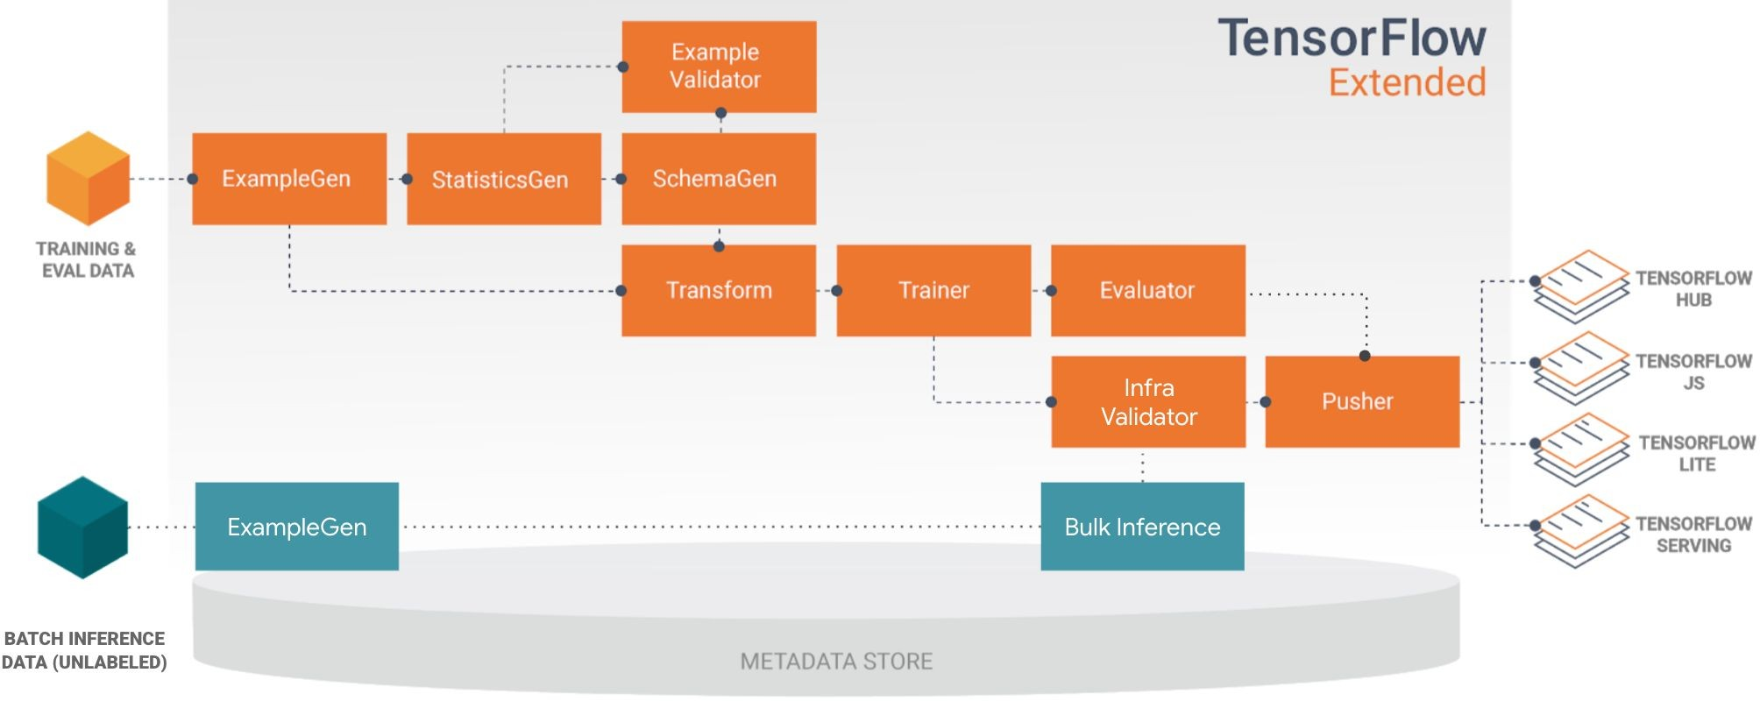
Orchestrate your ML workﬂows with TFX
Pre-built and standard components, and 3 styles of custom components
Components can also be containerized
Examples of things you can do with TFX components:
Data augmentation, upsampling, or downsampling
Anomaly detection based on conﬁdence intervals or autoencoder reproduction error
Interfacing with external systems like help desks for alerting and monitoring
… and more!

Slide 47

Hello TFX

Slide 48
Anatomy of a TFX Component
Component Speciﬁcation
The component's input and output contract Executor Class
Implementation of the component’s processing Component Class
Combines the speciﬁcation with the executor to create a TFX component

Slide 49


TFX components at runtime
Types of custom components
Fully custom components combine the speciﬁcation with the executor
Python function-based components use a decorator and argument annotations
Container-based components wrap the component inside a Docker container
Driver
Executor
Publisher
Metadata Store

Slide 50
Python function-based components
@component
def MyValidationComponent( model: InputArtifact[Model],
blessing: OutputArtifact[Model], accuracy_threshold: Parameter[int] = 10,
) -> OutputDict(accuracy=float):
'''My simple custom model validation component.'''
accuracy = evaluate_model(model) if accuracy >= accuracy_threshold:
write_output_blessing(blessing)
return {
'accuracy': accuracy
}

Slide 51
Container-based components
from tfx.dsl.component.experimental import container_component from tfx.dsl.component.experimental import placeholders
from tfx.types import standard_artifacts
grep_component = container_component.create_container_component( name='FilterWithGrep',
inputs={'text': standard_artifacts.ExternalArtifact}, outputs={'filtered_text': standard_artifacts.ExternalArtifact}, parameters={'pattern': str},
...
)

Slide 52
Container-based components
grep_component = container_component.create_container_component(
...
image='google/cloud-sdk:278.0.0', command=[
'sh', '-exc', '''
...
''',
'--pattern', placeholders.InputValuePlaceholder('pattern'), '--text', placeholders.InputUriPlaceholder('text'),
'--filtered-text', placeholders.OutputUriPlaceholder('filtered_text'),
],
)

Slide 53
Fully custom components
Deﬁne custom component spec, executor class, and component class
Component reusability
Reuse a component spec and implement a new executor that derives from an existing component

Slide 54
Deﬁning input and output speciﬁcations
class HelloComponentSpec(types.ComponentSpec): INPUTS = {
# This will be a dictionary with input artifacts, including URIs 'input_data': ChannelParameter(type=standard_artifacts.Examples),
}
OUTPUTS = {
# This will be a dictionary which this component will populate 'output_data': ChannelParameter(type=standard_artifacts.Examples),
}
PARAMETERS = {
# These are parameters that will be passed in the call to create an instance of this component 'name': ExecutionParameter(type=Text),
}

Slide 55
Implement the executor
class Executor(base_executor.BaseExecutor):
def Do(self, input_dict: Dict[Text, List[types.Artifact]], output_dict: Dict[Text, List[types.Artifact]], exec_properties: Dict[Text, Any]) -> None:
...

Slide 56
Implement the executor
class Executor(base_executor.BaseExecutor):
...
split_to_instance = {}
for artifact in input_dict['input_data']:
for split in json.loads(artifact.split_names): uri = os.path.join(artifact.uri, split) split_to_instance[split] = uri
for split, instance in split_to_instance.items(): input_dir = instance
output_dir = artifact_utils.get_split_uri( output_dict['output_data'], split)
for filename in tf.io.gfile.listdir(input_dir): input_uri = os.path.join(input_dir, filename) output_uri = os.path.join(output_dir, filename)
io_utils.copy_file(src=input_uri, dst=output_uri, overwrite=True)

Slide 57
Make the component pipeline-compatible
from tfx.types import standard_artifacts from hello_component import executor
class HelloComponent(base_component.BaseComponent): SPEC_CLASS = HelloComponentSpec
EXECUTOR_SPEC = ExecutorClassSpec(executor.Executor)

Slide 58
Completing the component class
class HelloComponent(base_component.BaseComponent):
...
def init (self,
input_data: types.Channel = None, output_data: types.Channel = None, name: Optional[Text] = None):
if not output_data:
examples_artifact = standard_artifacts.Examples() examples_artifact.split_names = input_data.get()[0].split_names output_data = channel_utils.as_channel([examples_artifact])
spec = HelloComponentSpec(input_data=input_data, output_data=output_data, name=name) super(HelloComponent, self). init (spec=spec)

Slide 59
Assemble into a TFX pipeline
def _create_pipeline():
...
example_gen = CsvExampleGen(input_base=examples)
hello = component.HelloComponent( input_data=example_gen.outputs['examples'], name='HelloWorld')
statistics_gen = StatisticsGen(
examples=hello.outputs['output_data'])
...
return pipeline.Pipeline(
...
components=[example_gen, hello, statistics_gen, ...],
...
)

Slide 60
Model Management and Deployment Infrastructure
Managing Model Versions

Slide 61










Why versioning ML Models?
Version Control
Team 3
Team 1
Server
Team 2
Code
Data
Model version x
Conﬁg

Slide 62
How ML Models are versioned?
How software is versioned?
Version: MAJOR.MINOR.PATCH
MAJOR: Contains incompatible API changes
MINOR: Adds functionality in a backwards compatible manner
PATCH: Makes backwards compatible bug ﬁxes
ML Models versioning
No uniform standard accepted yet
Different organizations have different meanings and conventions

Slide 63
A Model Versioning Proposal
Version: MAJOR.MINOR.PIPELINE
MAJOR: Incompatibility in data or target variable
MINOR: Model performance is improved
PIPELINE: Pipeline of model training is changed

Slide 64
Retrieving older models
Can ML framework be leveraged to retrieve previously trained models?
ML framework may internally be versioning models

Slide 65
What is model lineage?
Code
Data
Model version x
Conﬁg
Artifacts: information needed to preprocess data and generate result (code, data, conﬁg, model)
ML orchestration frameworks may store operations and data artifacts to recreate model
Post training artifacts and operations are usually not part of lineage

Slide 66




What is a model registry?
Trained Model
Model Registry
Staging Production Archived
Metadata Artifacts
Model
Parameters
Central repository for storing trained ML models
Provides various operations of ML model development lifecycle
Promotes model discovery, model understanding, and model reuse
Integrated into OSS and commercial ML platforms

Slide 67
Metadata stored by model registry
Trained Model
Model Registry
Staging Production Archived
Metadata Artifacts
Model
Parameters
Model versions
Model serialized artifacts
Free text annotations and structured properties
Links to other ML artifact and metadata stores

Slide 68
Capabilities Enabled by Model Registries
Model search/discovery and understanding
Approval/Governance
Collaboration/Discussion
Streamlined deployments
Continuous evaluation and monitoring
Staging and promotions

Slide 69
Examples of Model Registries
Azure ML Model Registry
SAS Model Manager
MLﬂow Model Registry
Google AI Platform
Algorithmia

Slide 70
Model Management and Deployment Infrastructure
Continuous Delivery

Slide 71
What is Continuous Integration (CI)
 | Triggered when new code is pushed or committed
 | Build packages, container images, executables etc
 | Performs unit and integration tests for the components
 | Delivers the ﬁnal packages to Continuous Delivery pipeline
Continuous Integration

Slide 72
What is Continuous Delivery (CD)
Deploys new code and trained models to the target environment
Continuous Delivery
Ensures compatibility of code and models with the target environment
Checks the prediction service performance of the model before deploying

Slide 73
CI/CD Infrastructure
Model analysis
Data analysis
Orchestrated experiment
Source code
CI: Build, test, & package pipeline components
Source
Packages
Repository
Feature store
CD: Pipeline Deployment
development/test
staging/pre-production/production
CD: Model serving
Performance monitoring
Prediction service

Slide 74
Unit Testing in CI
Testing that each component in the pipeline produces the expected artifacts.
Unit testing in CI
Unit testing Data
Unit testing Model performance

Slide 75
Unit Testing Input Data
Test feature engineering logic
Test values
Input data
Test format

Slide 76
Unit Testing Model Performance
Test model methods
Test the model performance
metrics
Model
Test to avoid inherent bias
Test to avoid NaN values,
empty strings

Slide 77
ML Unit Testing Considerations
Mocking
Data Coverage
Code Coverage
Mocks of datasets are especially important for ML. They should cover edge and corner cases.
Your mocks should sparsely cover the same space as your data, but with a much smaller dataset.
Use code coverage libraries to make sure that you are not missing unit tests for any part of our code.

Slide 78
Infrastructure validation
When to apply infrastructure validation
Before starting CI/CD as part of model training
Can also occur as part of CI/CD as a last check to verify that the model is deployable to the serving infrastructure
TFX InfraValidator
TFX InfraValidator takes the model, launches a sand-boxed model server with the model, and sees if it can be successfully loaded and optionally queried
InfraValidator is using the same model server binary, same resources, and same server conﬁguration as production

Slide 79
Model Management and Deployment Infrastructure
Progressive Delivery

Slide 80
Progressive Delivery
Progressive Delivery is essentially an improvement over Continuous Delivery
Initial Stage
Later Stage
Decrease deployment risk
Faster deployment
Gradual rollout and ownership
Deliver changes ﬁrst to small, low risk audiences
Expand to larger riskier audience

Slide 81
Complex Model Deployment Scenarios
You can deploy multiple models performing same task
Deploying competing models, as in A/B testing
Deploying as shadow models, as in Canary testing

Slide 82




Blue/Green deployment
User Trafﬁc
No downtime
Quick rollback & reliable
Smoke testing in production environment
Load Balancer
Code Version 2 (Green)
The diagrams are illustrations based on:
https://dev.to/mostlyjason/intro-to-deployment-strategies-blue-green-canary-and-more-3a3#
Code Version 1 (Blue)

Slide 83



Canary deployment
User Trafﬁc
Load Balancer
Version 1
Version 2

Slide 84
Canary deployment
User Trafﬁc
Load Balancer
Version 1
Version 2

Slide 85
Canary deployment
User Trafﬁc
Load Balancer
Version 1
Version 2

Slide 86
Canary deployment
User Trafﬁc
Load Balancer
Version 1
Version 2

Slide 87
Live Experimentation
Model metrics are usually not exact matches for business objectives
Example: Recommender systems
Model trained on clicks
Business wants to maximize proﬁt
Example: Different products have different proﬁt margins

Slide 88
Live Experimentation: A/B Testing
Client
Users are divided into two groups
Users are randomly routed to different models in environment
You gather business results from each model to see which one is performing better
Application
Model A
Model B

Slide 89






















Live Experimentation: A/B Testing
A
B
Large use data is fed to the system
The system randomly assigns people into two groups
Relationship between the treatment received and the observed difference are analysed to validate the hypothesis

Slide 90


Live Experimentation: Multi-Armed Bandit (MAB)
Uses ML to learn from test results during test
Dynamically routes requests to winning models
Eventually all requests are routed to one model
Minimizes use of low-performing models

Slide 91






Live Experimentation: Contextual Bandit
Similar to
multi-armed bandit, but also considers context of request
Example: Users in different climates

